Slide 1

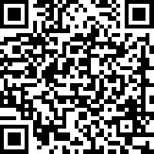















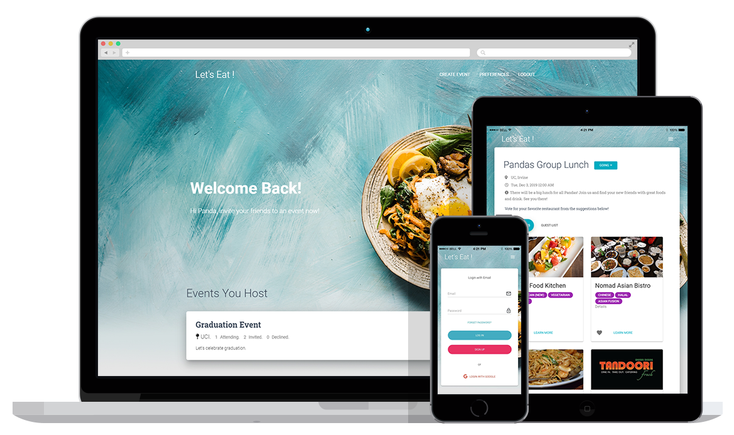



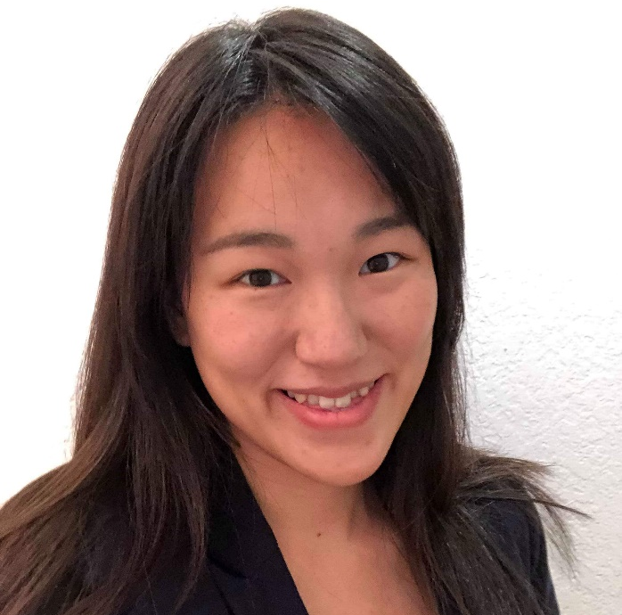
WITH FROM PANDAS
PITCH
BUSINESS MODEL
Let’s Eat is a web Application to simplify the process of arranging and scheduling food outings
Our product recommends restaurants based on the food interests and dietary restrictions specified by attendees
Our product is free to use for users who want to arrange a dining plan
Primary income is from restaurant advertisements
Sponsored restaurants will be featured more frequently in our suggestions
PROBLEM/OPPORTUNITY
 | Number per Month | Cost per Action | Revenue
Views | 20,000 | $0.10 | $2,000
Clicks | 10,000 | $0.20 | $2,000
Total | N/A | N/A | $4,000
Hosting a dining plan for a group is challenging and time consuming
Everyone has different food interests, dietary restrictions, and availability
To avoid conflicts, not everyone shares their opinions or preferences
SOLUTION/PRODUCT
COSTS & EXPENSES
Create and manage dining invitations as a host or respond as a guest
Store food preferences and dietary restrictions of each user during sign up
Suggest restaurants based on their saved preferences
Users can anonymously vote for their favorite restaurants
The restaurant with most upvotes will be selected and attendees notified
The costs and expenses include: Google Cloud Service - Firebase, Labor, and Marketing/Advertising on social media platforms like Instagram
Marketing | Labor | Database | Total
$500 | $12,500 | $25 | $13,025
TECHNOLOGY STACK
MARKET
Our project is a Web Application with:
React.js for Front-End
Node.js for Back-End
Firebase for Database
GCP for Hosting
According to Statista, the food and drink sales of the restaurant industry reached $799 billion in 2017
Around 47% of Americans eat out for “socializing with friends and family”, which ranks as the #1 reason for Americans to dine out at restaurants
Anyone who eats out with others is our potential customer
BI-WEEKLY SPRINTS
PRODUCT
Explored Technologies Brainstormed Features and Workflow NodeJS with Express Integrated React with NodeJS
Setup Development Environment Client-Side Routing setup Firebase Authentication Integration with Yelp API
Implemented Create, Read, Update and Delete of User Events Setup Survey Page Integration with SendGrid API
Implemented Restaurant Suggestion Implemented Restaurant Voting Mechanism Improve User Experience
1
2
3
4
TEAM
Shiteng Gao
shitengg@uci.edu
UI Designer, Front-End Developer
Product Manager
Sunnyhith Kanakanti
skanakan@uci.edu
Full Stack Developer
Product Manager
Tzu-Yu (Zoe) Chao
tzuyuc@uci.edu
Data Engineer, Back-End Developer
Product Manager

